Slide 1


Artificial and Computational Intelligence
AIMLCZG557
Contributors & Designers of document content : Cluster Course Faculty Team
M1 : Introduction &
M2 : : Problem Solving Agent using Search
BITS Pilani
Pilani Campus
Presented by
Dr. Srinivasa L.Chakravarthy
Chakri.ls@wilp.bits-Pilani.ac.in

Slide 2

Artificial and Computational Intelligence
Disclaimer and Acknowledgement
Few content for these slides may have been obtained from prescribed books and various other source on the Internet
I hereby acknowledge all the contributors for their material and inputs and gratefully acknowledge people others who made their course materials freely available online.
.I have provided source information wherever necessary
This is not a full fledged reading materials. Students are requested to refer to the textbook w.r.t detailed content of the presentation deck that is expected to be shared over e-learning portal - taxilla.
I have added and modified the content to suit the requirements of the class dynamics & live session’s lecture delivery flow for presentation
Slide Source / Preparation / Review:
From BITS Pilani WILP: Prof.Raja vadhana, Prof. Indumathi, Prof.Sangeetha
From BITS Oncampus & External : Mr.Santosh GSK

Slide 3

Course Plan
M1 | Introduction to AI
M2 | Problem Solving Agent using Search
M3 | Game Playing
M4 | Knowledge Representation using Logics
M5 | Probabilistic Representation and Reasoning
M6 | Reasoning over time
M7 | Ethics in AI

Slide 4
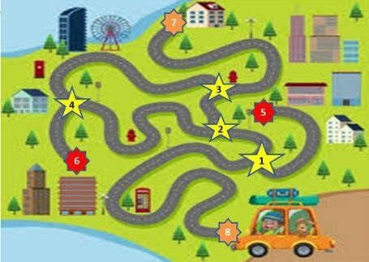
Traveller’s Problem

Slide 5
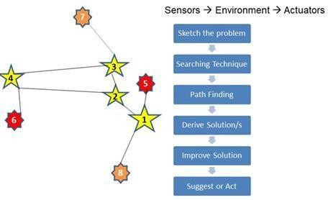
Traveller’s Problem

Slide 6
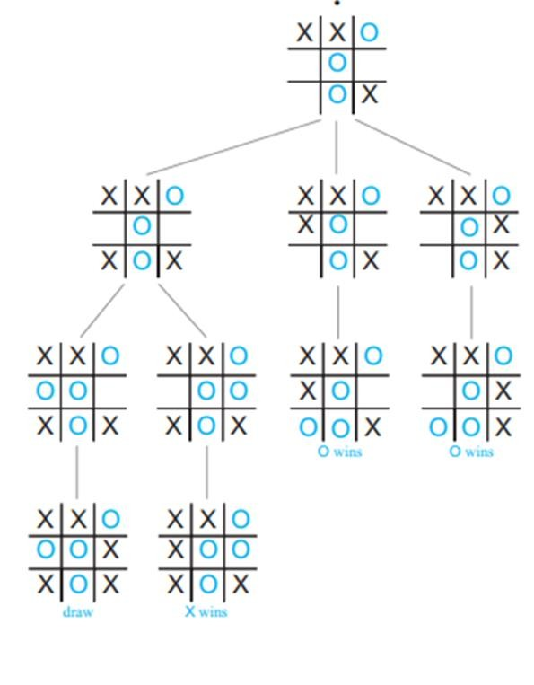
Traveller’s Problem

Slide 7

Rational Agents
BITS Pilani, Deemed to be University under Section 3 of UGC Act, 1956

Slide 8
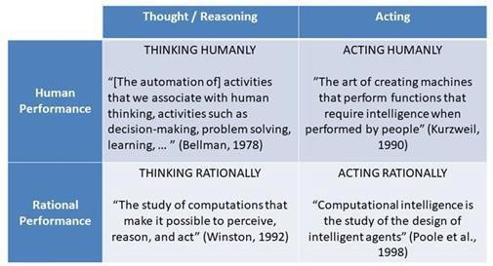
Rational Agent
Design Principles & Techniques
BITS Pilani, Deemed to be University under Section 3 of UGC Act, 1956

Slide 9
Acting Rationally
The Rational Agent Approach
An agent is an entity that perceives and acts
This course is about designing rational agents
Abstractly, an agent is a function from percept histories to actions: [f: P* →
A]
For any given class of environments and tasks, we seek the agent (or class of agents) with the best performance
Computational limitations make perfect rationality unachievable
Design best program for given machine resources
BITS Pilani, Deemed to be University under Section 3 of UGC Act, 1956

Slide 10
Properties ofRational Agent
Omniscience : Expected Vs Actual Performance
Learning Capability : Apriori Knowledge
Autonomous in decision making: An agent is autonomous if its behaviour is determined by its own experience (with ability to learn and adapt)

Slide 11
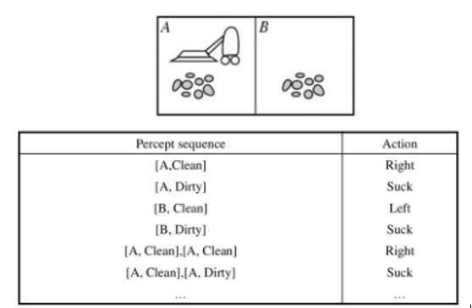
Intelligent Agent
Rational Agent is one that acts to achieve the best outcome or the best expected outcome even under uncertainty
Maps / Tabulated / Programmed
 | Agent Function
Percept
Sequence
Action

Slide 12
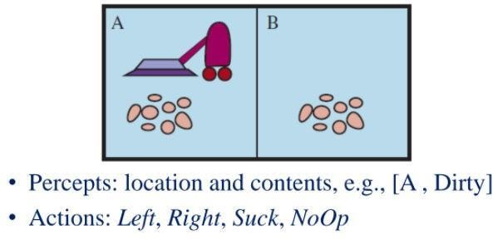
Intelligent Agent
Performance measure: An objective criterion for success of an agent's behaviour
E.g., performance measure of a vacuum-cleaner agent
» amount of dirt cleaned up
» amount of time taken
» amount of electricity consumed
» amount of noise generated, etc.
PEAS Design

Slide 13

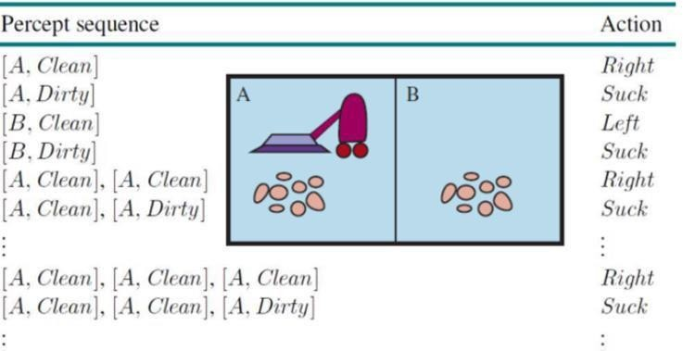
Intelligent Agent

Slide 14

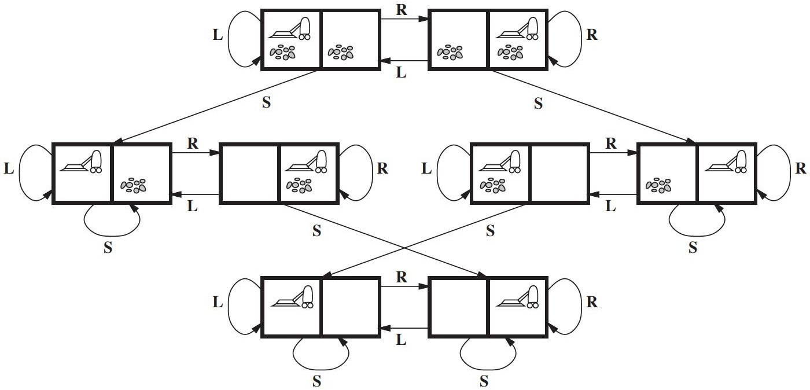
Vacuum WorldProblem

Slide 15
PEAS Environment
Design on what an application wants the agent to do in the environment
Agent | Performance | Environment | Sensors | Actuators
Medical diagnosis system | Healthy patient, reduced costs | Patient, hospital, staff | Keyboard entry of symptoms, findings, patient’s answers | Display of questions, tests, diagnosis, treatments, referrals
Satellite Image analysis system | Correct image categorization | Downlink from orbiting satellite | Color pixel analysis | Display of scene categorization
Interactive English tutor | Student’s score on test | Set of students, testing agency | Keyboard entry | Display of exercises, suggestions, corrections

Slide 16


- Lab Example
Path finding Robot
 |  |  |  |  |  | 0
 |  |  |  |  |  | 1
 |  |  |  |  |  | 2
 |  |  |  |  |  | 3
 |  |  |  |  |  | 4
 |  |  |  |  |  | 5
 |  |  |  |  |  | 6
0 | 1 | 2 | 3 | 4 | 5

Slide 17
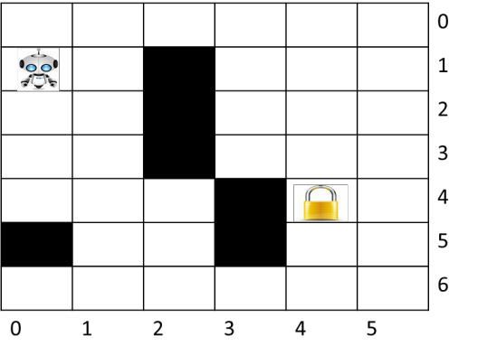
PEAS Environment
Agent
Performance
Environment
Sensors

Slide 18
Dimensions of Task Environment
Sensor Based:
Observability : Full Vs Partial
Action Based:
Dependency : Episodic Vs Sequential
State Based:
No.of.State : Discrete Vs Continuous
Agent Based:
> Cardinality : Single Vs MultiAgent
Action & State Based:
State Determinism : Deterministic Vs Stochastic
Change in Time : Static Vs Dynamic
| Strategic

Slide 19
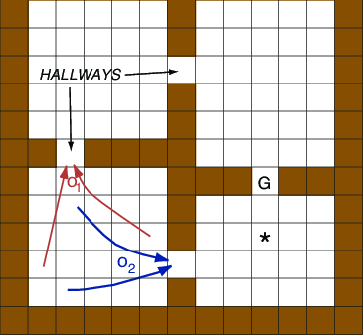
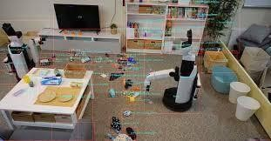
Task Environment
A rational agent is built to solve a specific task. Each such task would then have a
different environment which we refer to as Task Environment
Based on the applicability of each technique for agent implementation its task
environment design is determined by multiple dimension
Sensor Based:
Observability : Full Vs Partial

Slide 20
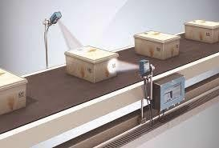
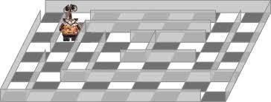

Task Environment
Action Based:
Dependency : Episodic Vs Sequential

Slide 21
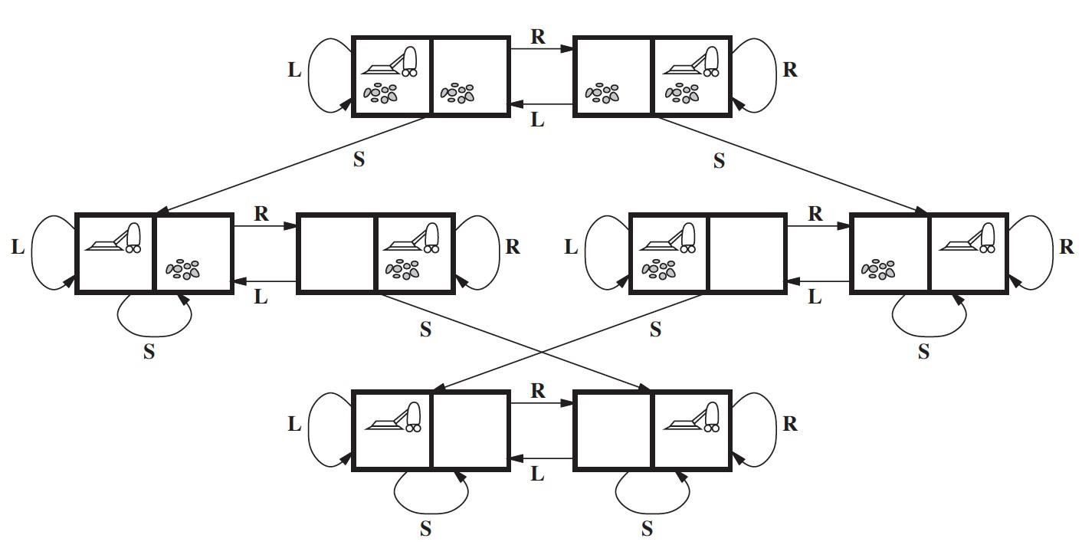
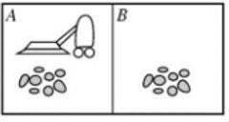
Task Environment
State Based:
No.of.State : Discrete Vs Continuous

Slide 22
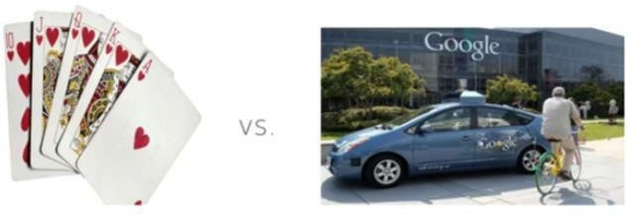
Task Environment
State Based:
No.of.State : Discrete Vs Continuous

Slide 23
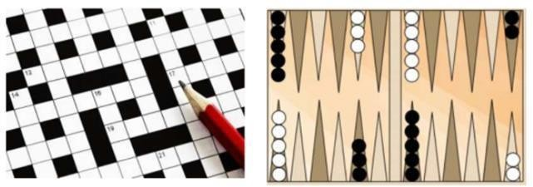
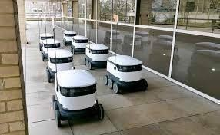
Task Environment
Action & State Based:
State Determinism : Deterministic Vs Stochastic | Strategic
(If the environment is deterministic except for the actions of other agents, then
the environment is strategic)

Slide 24
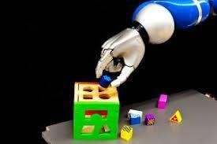
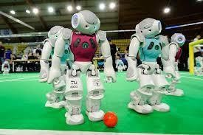
Task Environment
Agent Based:
> Cardinality : Single Vs MultiAgent

Slide 25
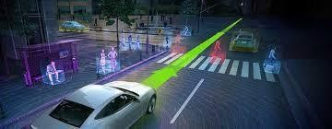
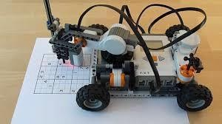
Task Environment
Action & State Based:
Change in Time : Static Vs Dynamic
(The environment is semi dynamic if the environment itself does not change with the passage of time but the agent's performance score does)

Slide 26
Task Environment
Task Environment | Fully vs Partially Observable | Single vs Multi- Agent | Deterministic vs Stochastic | Episodic vs Sequential | Static vs Dynamic | Discrete vs Continuous
Medical diagnosis system | Partially | Single | Stochastic | Sequential | Dynamic | Continuous
Satellite Image Analysis System | Fully | Single | Deterministic | Episodic | Static | Continuous
Interactive English tutor | Partially | Multi | Stochastic | Sequential | Dynamic | Discrete

Slide 27
Path finding Robot
- Lab Example
Agent
Observability
0
No.of.Agents
1
2
No.of.States
3
4
Determinism
5
6
Dynamicity
0
1
2
3
4
5
Output Dependency

Slide 28
Learning Objective Achieved
At the end of this class , students Should be able to:
Identify the requirement for AI solutions for given problem
Understand the significance of State based representations
Design the PEAS (Performance, Environment, Actuators, Sensors) for given
problem
Identify dimensions of TASK environment

Slide 29

Next Class Plan
Structure of Agents-Architectures
Problem Solving Agents Problem Formulation Uninformed Search Algorithms
BITS Pilani, Pilani Campus

Slide 30

Required Reading: AIMA - Chapter #2
Thank You for all your Attention
Note : Some of the slides are adopted from AIMA TB materials
BITS Pilani, Pilani Campus

